Slide 1
Green foot Final Project:
Game Description
Keila Calderon

Slide 2
Gameplay Description
The Domino Effect is a two-dimensional game in which players have to intercept incoming bombs in order to defend their islands. It is played by moving a “Diplomat” across the sky background to intercept incoming bombs.The game is staged as a series of cycles of increasing difficulty. Each cycle contains a random number of incoming enemy weapons. The game inevitably ends when the score is less than zero meaning that the player has lost. If the player has maintained a positive score without running out of time, they have won the game.

Slide 3
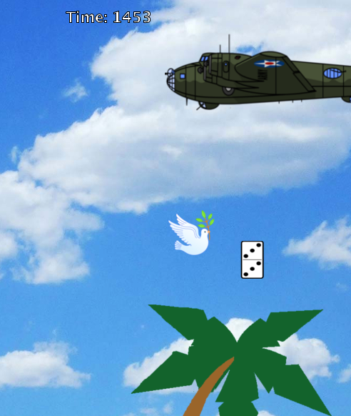
Additional Gameplay Details
The game’s playing field is 1040 pixels wide by 800 pixels high
The playing field will have a bomber at the top left corner flying back and forth across the top of the screen
There is an interceptor below the bomber, depicted as a dove
The digit’s for the player’s score and time will be white.
The player’s score will be displayed at the top left corner of the screen
The time will be displayed at the top-middle of the screen

Slide 4
Additional Gameplay Details
The interceptor will be free to roam the playing field according to the player’s desire in order to intercept the “bombs”
The player is able to use the arrow keys in order to control the direction in which the player moves
Each time the player manages to intercept a bombs, the player will gain some points. If the player will gain 1 point for intercepting a banana, 2 for intercepting a missile, 3 for intercepting a domino from touching the islands.
As the bomber moves back and forth across the screen, randomly generated bombs will drop from the bombers y-coordinate and from a random x-coordinate so the generation of these bombs will not be predictable for the player.

Slide 5
Additional Gameplay Details
There are three types of bombs in this game
The Bananas will be the only weapon that drops throughout the first cycle at a random distribution
The Missiles and Dominos have an “eventual counter” set, so that as time progresses in the game these new weapons will be introduced
All the generation of these weapons will increase through a difficulty counter set

Slide 6
Additional Gameplay Details
There are five sounds incorporated into the game
The title screen will play its own sound
As the game is being played a background sound will be looped in the game
When the bombs have been intercepted by the player a sound will be played to confirm this action
Each time a bomb hits the island, an explosion sound will be played

